Slide 1
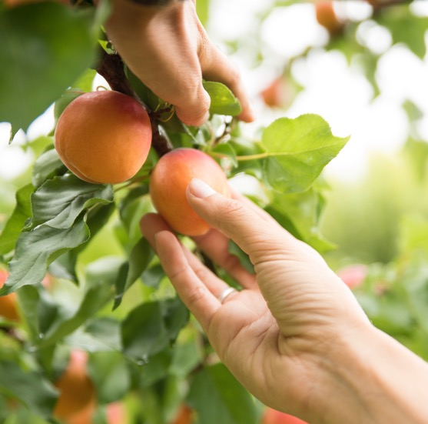
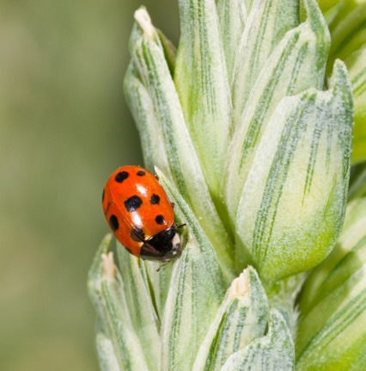

Investigating the genetic components of tuber bruising in a breeding population of tetraploid potatoes
Olivia Angelin-Bonnet, Susan Thomson, Matthieu Vignes, Patrick J. Biggs, Katrina Monaghan, Rebecca Bloomer, Kathryn Wright, Samantha Baldwin
Statistical Genetics Workshop, 10/04/2024
Notes:
Select one cover option and delete the unused variations.

Slide 2
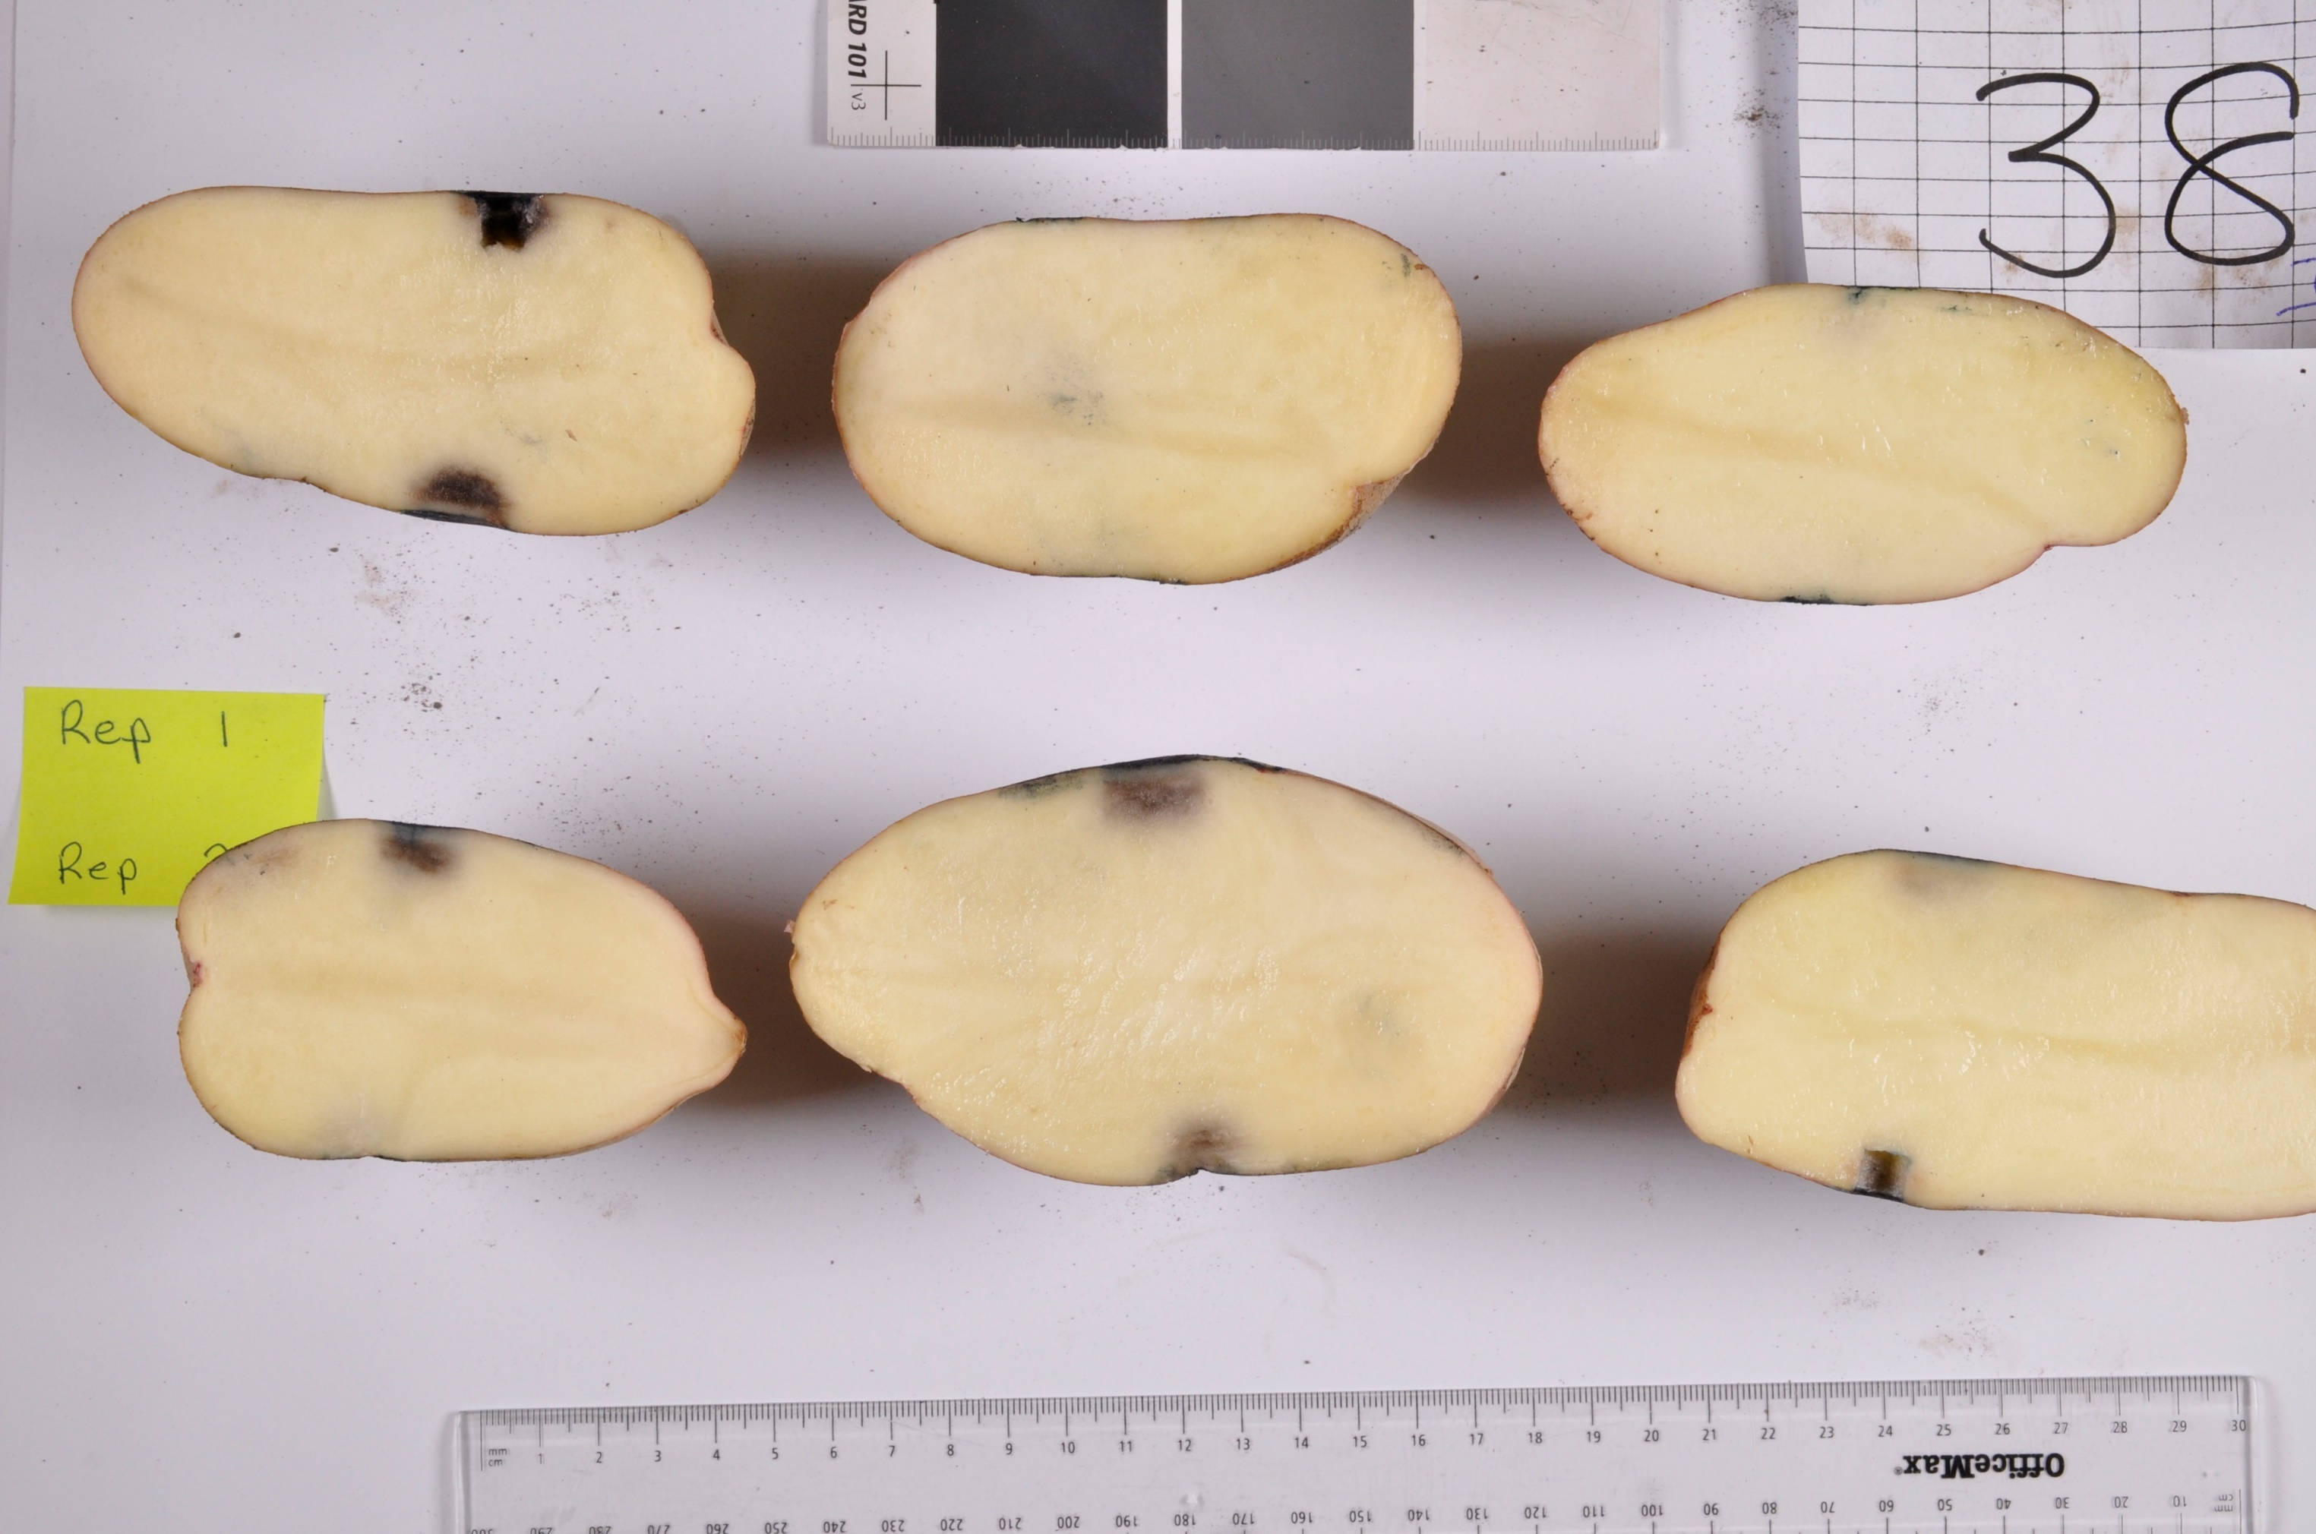
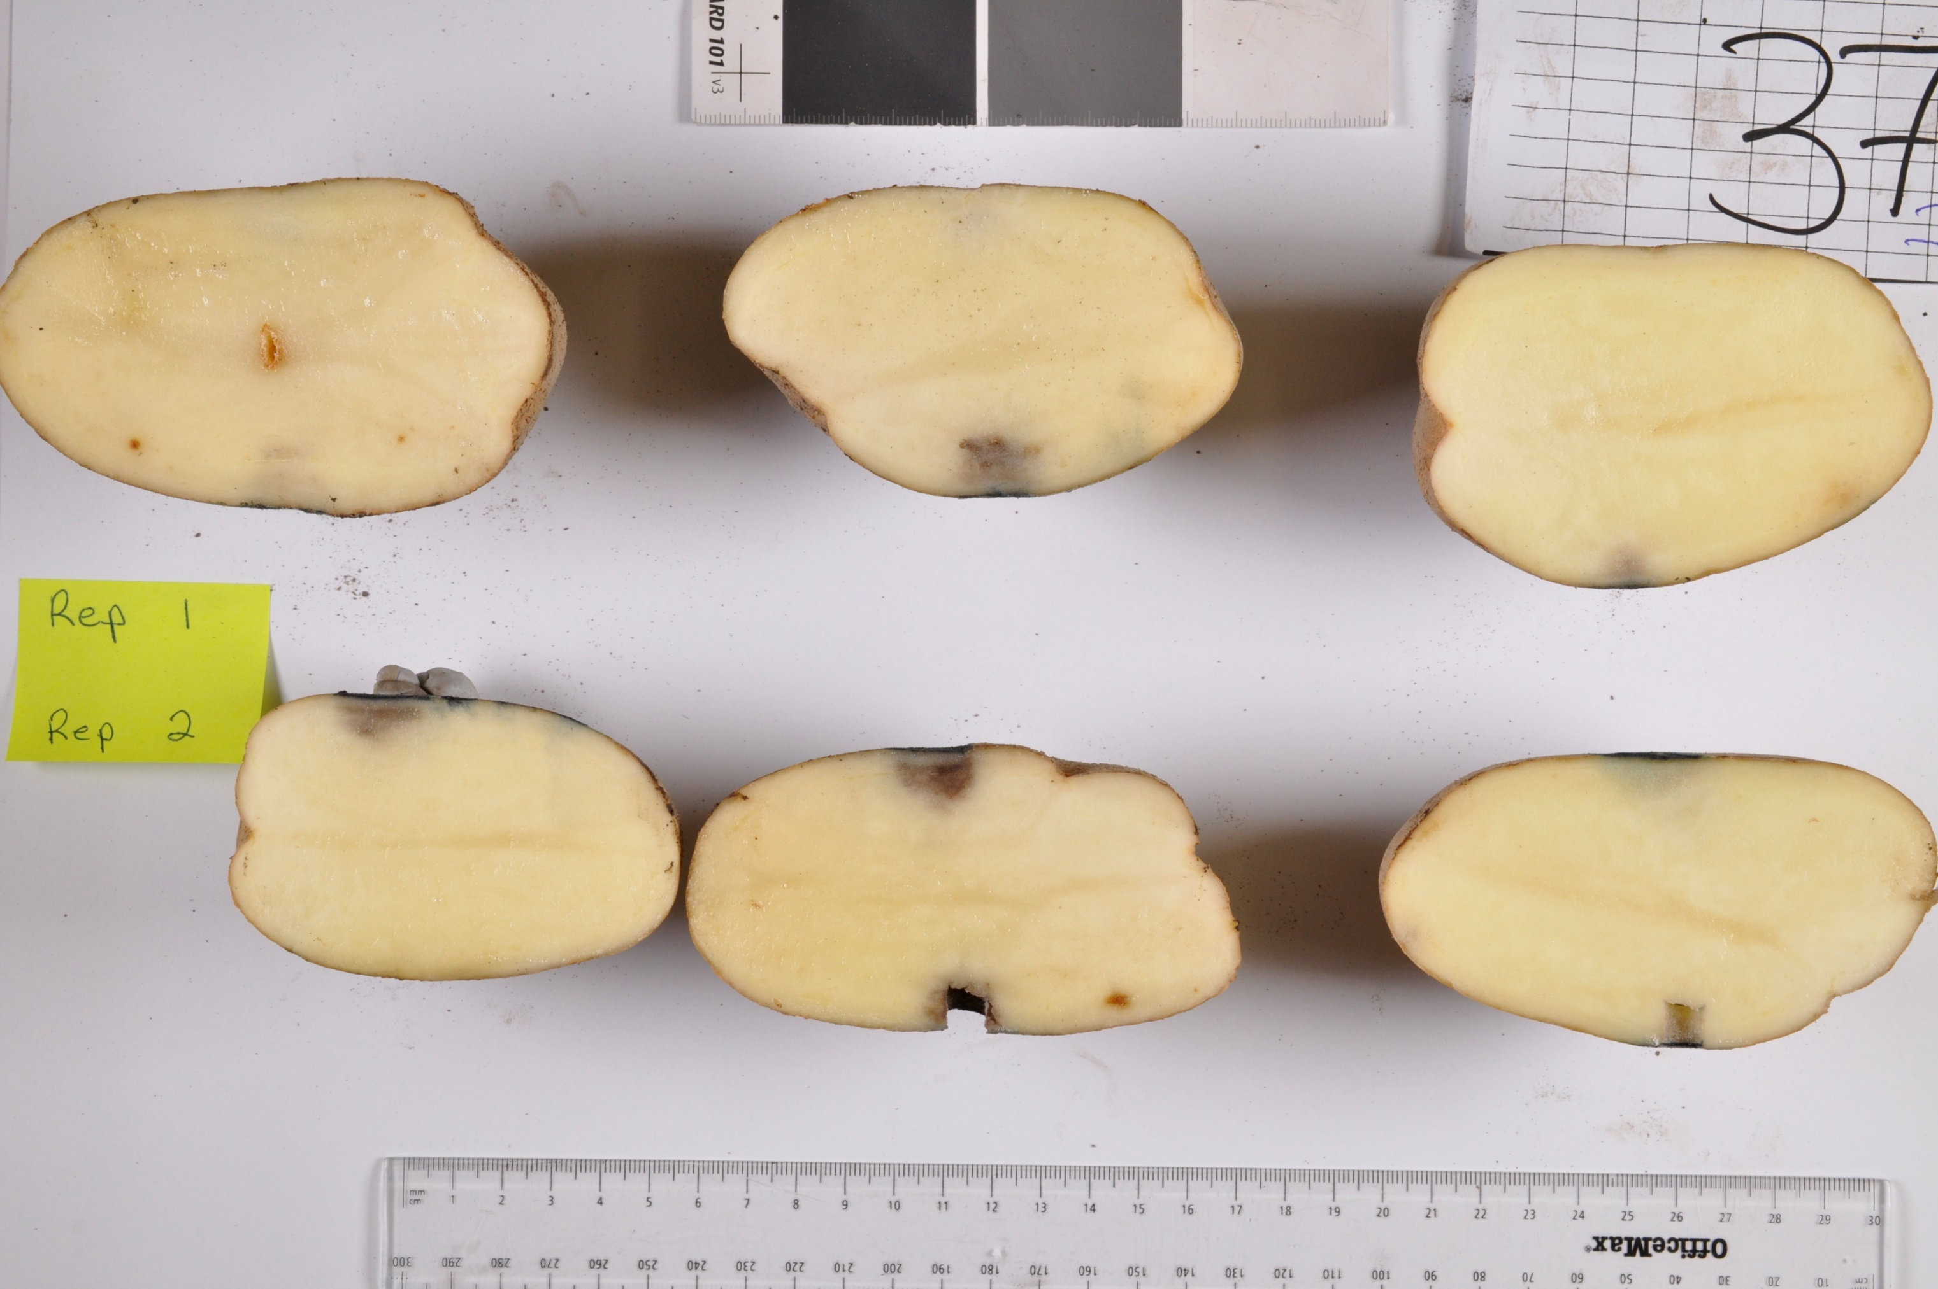
The research question
What are the genetic and molecular mechanisms involved in potato tuber bruising?

Slide 3
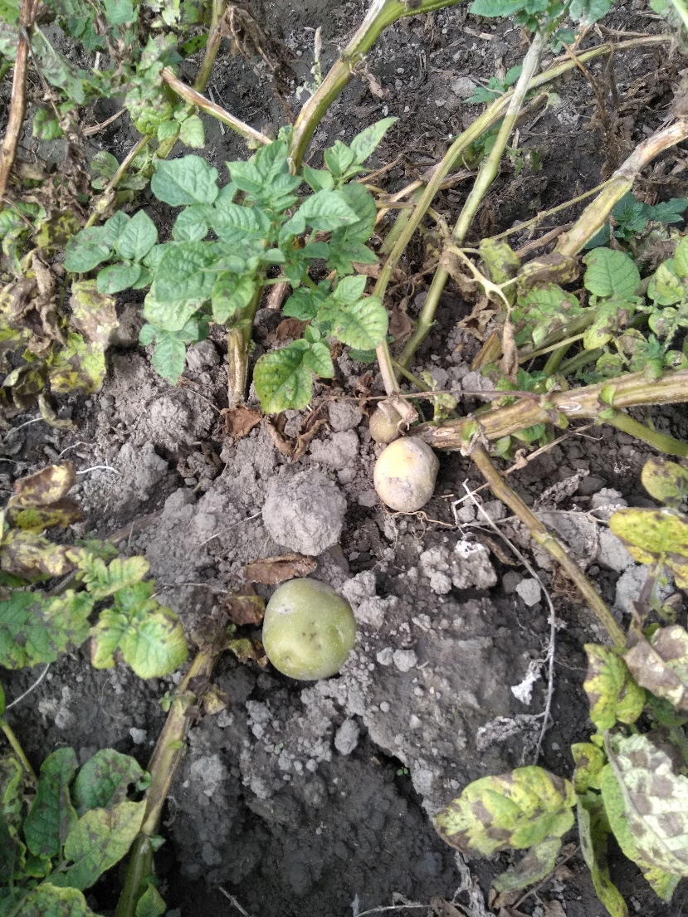
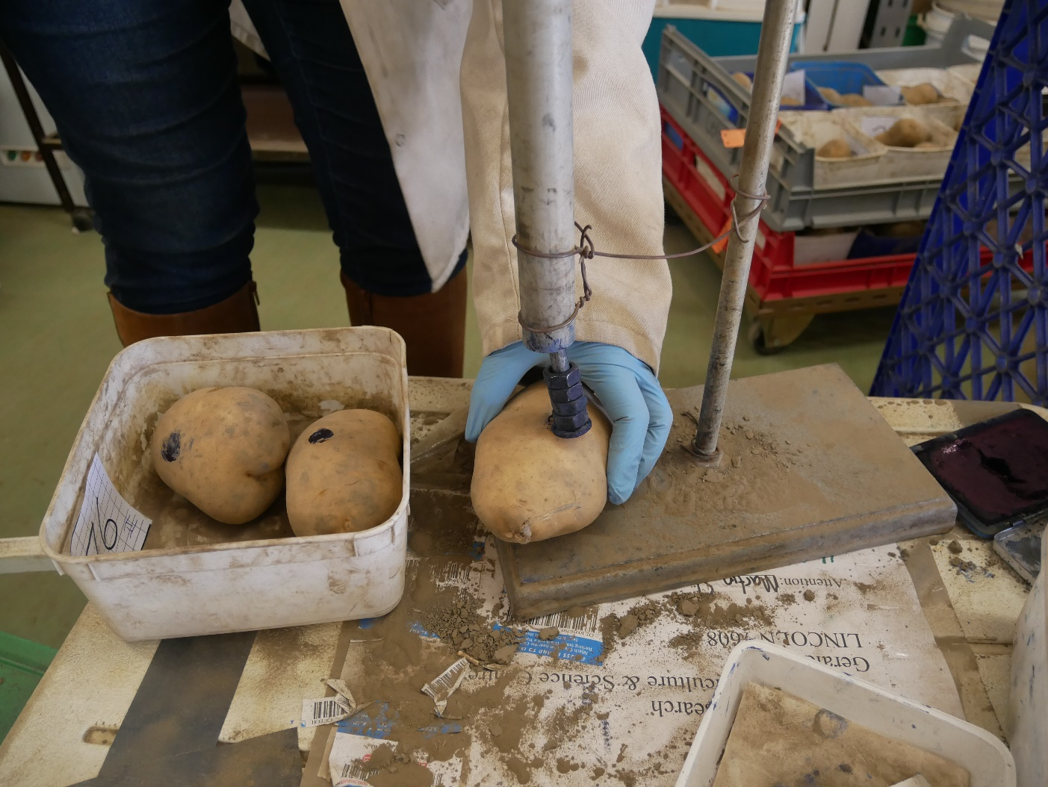
The experiment
Collection of half-sibling families from breeding programme: set of 2 (related) parents each crossed with a set of other (related) varieties
Potential issues:
Autotetraploid organism
Strong population structure
Selection bias on phenotype distribution

Slide 4
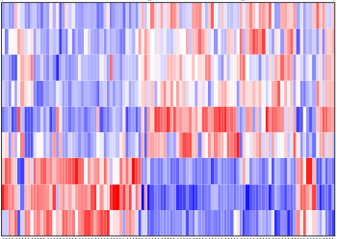
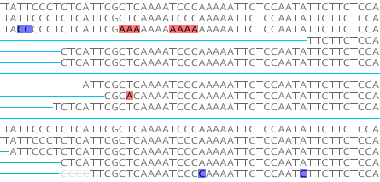
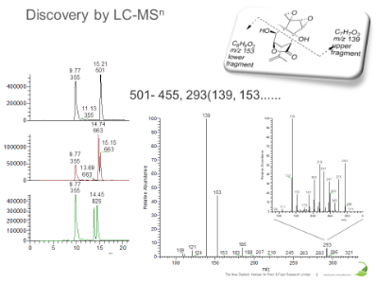
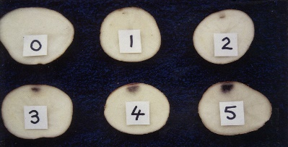
The multi-omics data
Genomics data
Capture sequencing
Transcriptomics data
RNAseq
Metabolomics data
LC-MS
Phenotypic data
Bruising score
Notes:
To answer this question, we collected several omics measurements: genomics data was obtained by capture sequencing, RNAseq was used to obtain gene expression measurement, untargeted metabolomics via LC-MS was performed, and a bruising experiment was set-up to obtain a bruising score for the measured samples.

Slide 5
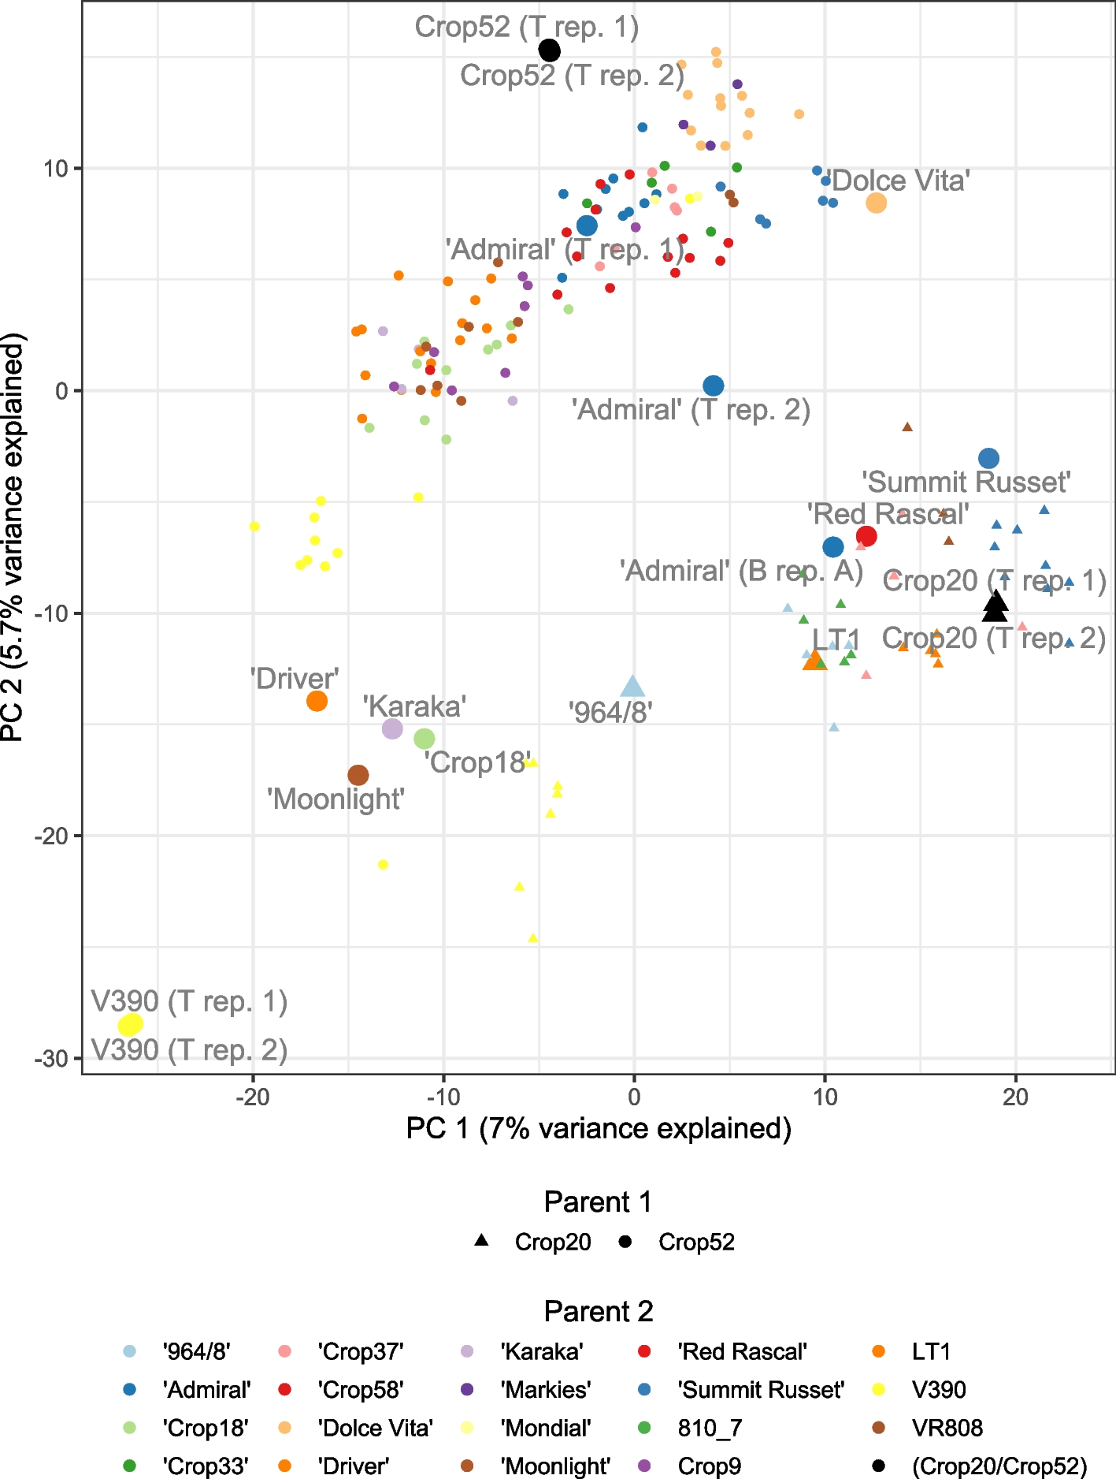
PCA on the genomics data
Angelin-Bonnet et al. BMC Plant Biology (2023)

Slide 6
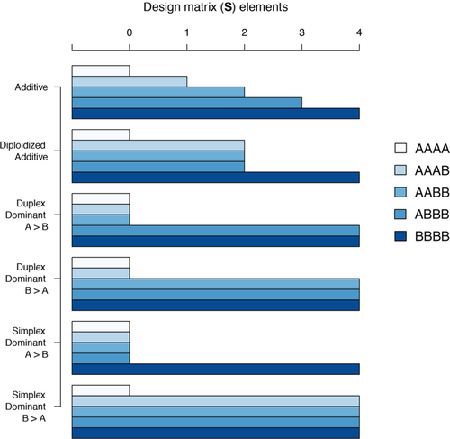
GWAS analysis with GWASpoly R package
Population settings
Naïve: no additional term
K: kinship matrix as covariance for polygenic effects
Q: sub-populations membership as covariates (Q_{STRUCTURE} or Q_{DAPC})
K + Q (K + Q_{STRUCTURE} or K + Q_{DAPC})
Genetic models
Rosyara et al. The Plant Genome (2016)

Slide 7
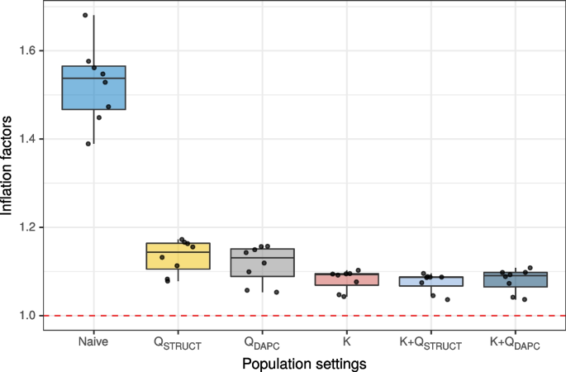
Comparing GWAS settings
Choice of genetic model has more impact than type of correction for population structure (as long as it is controlled for)
Results almost identical between STRUCTURE- and DAPC-based models
Retained K + Q_{STRUCTURE} as best reducing markers score inflation
5 significant markers (after p-value correction)

Slide 8
Differential expression with transcriptomics data
Differential expression of 25,163 genes between high- and low-bruising tubers
30 up-regulated and 27 down-regulated genes → mostly involved in stress response
GO domain | GO ID | GO term | Adjusted p-value | Number of genes
Molecular function | GO:0005524 | ATP binding | 0.006 | 2,010
Molecular function | GO:0005515 | Protein binding | 0.006 | 2,578
Biological process | GO:0006468 | Protein phosphorylation | 0.014 | 1,110
Molecular function | GO:0004672 | Protein kinase activity | 0.014 | 1,088
Molecular function | GO:0016740 | Transferase activity | 0.043 | 1,963
Molecular function | GO:0004674 | Protein serine/threonine kinase activity | 0.043 | 654

Slide 9
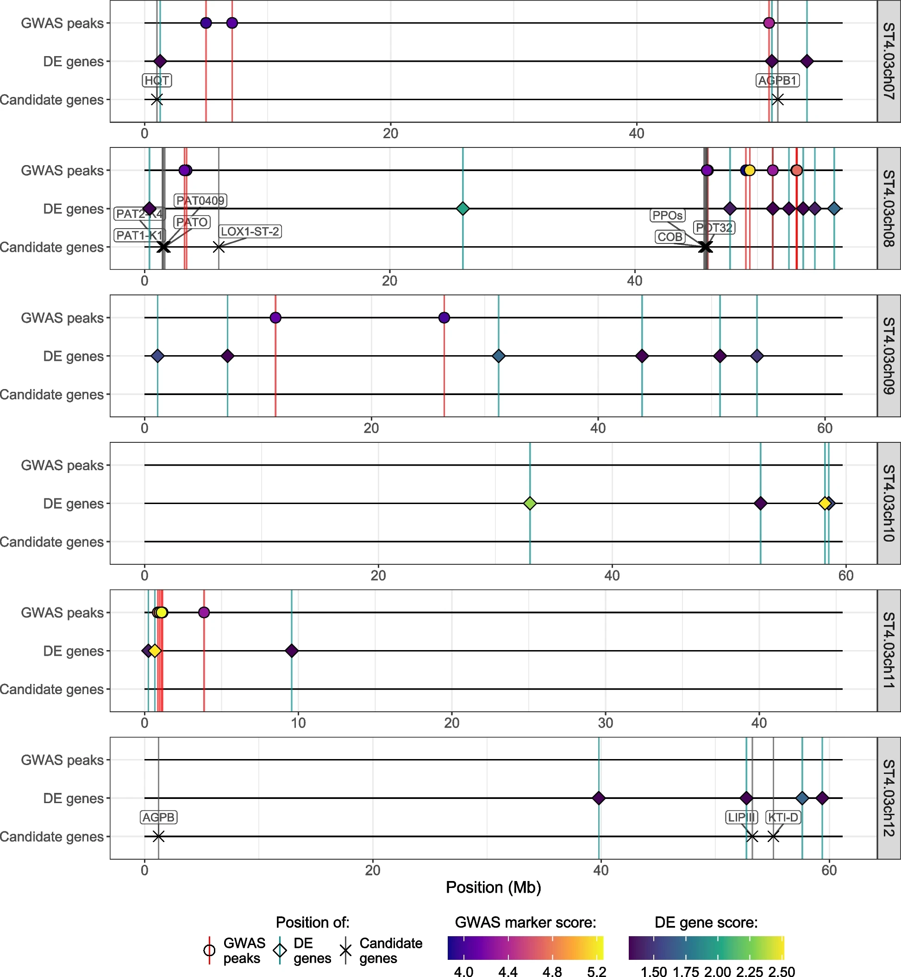
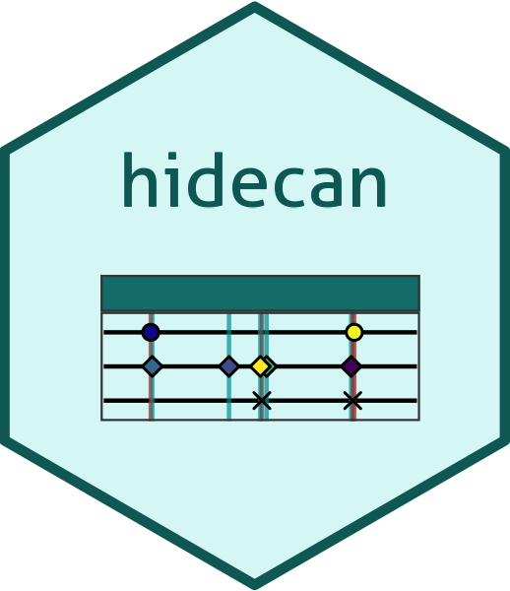
HIDECAN plots
Visualisation of GWAS high-scoring markers, DE genes and genes of interest into one figure
Implemented in the hidecan R package

Slide 10


Multi-omics network analysis
Conditional independences between feature
Multi-omics integration with DIABLO
Multi-omics causal network
Regulator
Target A
Target B
https://github.com/Plant-Food-Research-Open/moiraine
Bruising score
Correlated but independent
Notes:
These statistical independences can then be turned into causal independences, which can be represented as a causal graph where the nodes are features (genomic variants, genes, compounds), and edges between them indicate causal relationships.

Slide 11
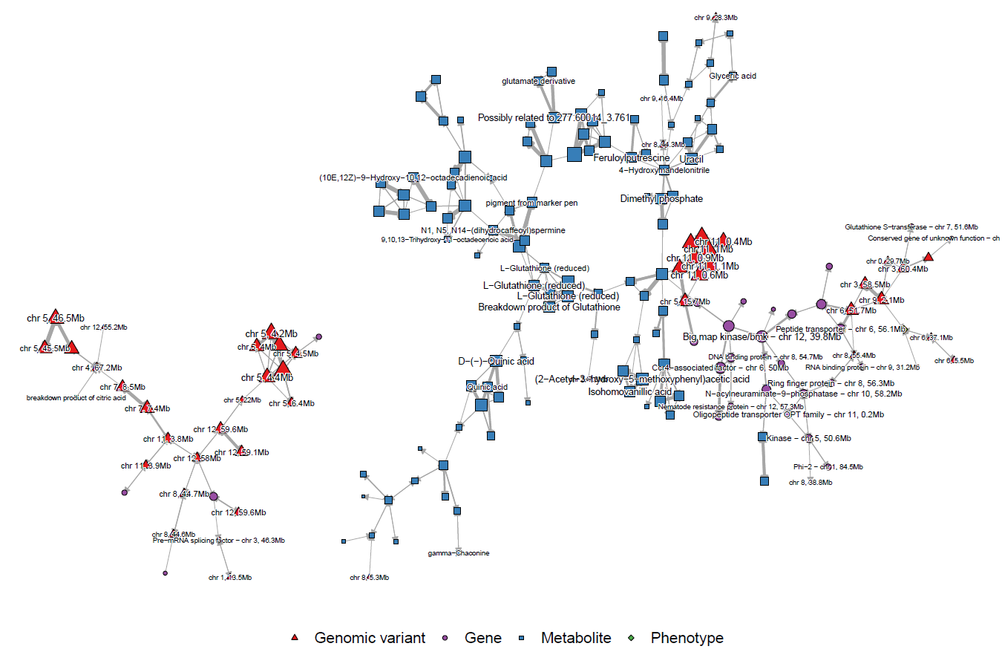
Multi-omics analysis
Bruising trait

Slide 12


Acknowledgments
Susan Thomson
Samantha Baldwin
Matthieu Vignes (Massey University)
Patrick Biggs (Massey University)
Rebecca Bloomer
Katrina Monaghan
Nigel Joyce
Martin Shaw
Kathryn Wright

Slide 13
olivia.angelin-bonnet@plantandfood.co.nz

Slide 14
Presentation disclaimer
Presentation for Statistical Genetics Workshop, Lincoln, 10 April 2024
Publication data: Angelin-Bonnet O, Thomson S, Vignes M, Biggs PJ, Monaghan K, Bloomer R, Wright K, Baldwin S. April 2024. Investigating the genetic components of tuber bruising in a breeding population of tetraploid potatoes. A Plant & Food Research PowerPoint presentation. PFR SPTS No. 25374,
Presentation prepared by: Olivia Angelin-Bonnet Statistical Scientist, Statistical Science
April 2024
Presentation approved by: Mark Wohlers Science Group Leader, Data Science April 2024
For more information contact: Olivia Angelin-Bonnet
Email: olivia.angelin-bonnet@plantandfood.co.nz
DISCLAIMER
The New Zealand Institute for Plant and Food Research Limited does not give any prediction, warranty or assurance in relation to the accuracy of or fitness for any particular use or application of, any information or scientific or other result contained in this presentation. Neither The New Zealand Institute for Plant and Food Research Limited nor any of its employees, students, contractors, subcontractors or agents shall be liable for any cost (including legal costs), claim, liability, loss, damage, injury or the like, which may be suffered or incurred as a direct or indirect result of the reliance by any person on any information contained in this presentation.
LIMITED PROTECTION
This presentation may be reproduced in full, but not in part, without the prior written permission of The New Zealand Institute for Plant and Food Research Limited. To request permission to reproduce the presentation in part, write to: The Science Publication Office, The New Zealand Institute for Plant and Food Research Limited – Postal Address: Private Bag 92169, Victoria Street West, Auckland 1142, New Zealand; Email: SPO-Team@plantandfood.co.nz.
COPYRIGHT
© COPYRIGHT (2024) The New Zealand Institute for Plant and Food Research Limited. All Rights Reserved. No part of this report may be reproduced, stored in a retrieval system, transmitted, reported, or copied in any form or by any means electronic, mechanical or otherwise, without the prior written permission of The New Zealand Institute for Plant and Food Research Limited. Information contained in this report is confidential and is not to be disclosed in any form to any party without the prior approval in writing of The New Zealand Institute for Plant and Food Research Limited. To request permission, write to: The Science Publication Office, The New Zealand Institute for Plant and Food Research Limited – Postal Address: Private Bag 92169, Victoria Street West, Auckland 1142, New Zealand; Email: SPO-Team@plantandfood.co.nz.
This report has been prepared by The New Zealand Institute for Plant and Food Research Limited (Plant & Food Research). Head Office: 120 Mt Albert Road, Sandringham, Auckland 1025, New Zealand, Tel: +64 9 925 7000, Fax: +64 9 925 7001. www.plantandfood.co.nz

Slide 15
Genomics data pre-processing
Variant calling (FreeBayes)
SNPs and samples filtering (quality and missing values)
~455,000 biallelic SNPs, 176 samples
Accounts for population structure
Genotype calling (polyRAD)
LD-based pruning (SNPRelate)
~72,900 SNPs
Population structure analysis (PCA, STRUCTURE, DAPC)

